Slide 1
SQA using Tensor Core
2021/04/26

Slide 2
Outline
Update results
Tensor core and its’ constraints
SQA
Method
Results
Future work

Slide 3
Results -1
Testcase | G1 | G22 | G48 | G65 | G77 | G81
#spin | 1024 | 2048 | 4096 | 8192 | 16384 | 32768
Actual #spin | 800 | 2000 | 3000 | 8000 | 14000 | 20000
Correlation | 19176 | 19990 | 6000 | 16000 | 28000 | 40000
#layers, M = 16
cudac++
GPU: RTX 3080
Database: Gset
#spin | 1024 | 2048 | 4096 | 8192 | 16384 | 32768
Shih fastest
GPU | 0.4641827 | 3.3816429 | 7.0664575 | 8.70533 | 107.3607445 | X
Tensor Core Unit (TC, TCU)
Old method / CPU (Last time) | 9.51994 | 23.42601 | 93.009529 | 544.421387 | 3947.98145 | 30947.7402

Slide 4
Results -2
M = 16, STEP=100
cudac++
GPU: RTX 3080
Database: Gset
Unit: (ms/MC STEP)
Testcase | G1 | G22 | G48 | G65 | G77 | G81
#spin | 1024 | 2048 | 4096 | 8192 | 16384 | 32768
Actual #spin | 800 | 2000 | 3000 | 8000 | 14000 | 20000
Correlation | 19176 | 19990 | 6000 | 16000 | 28000 | 40000
#spin | 1024 | 2048 | 4096 | 8192 | 16384 | 32768
Tensor Core Unit (TC, TCU)
Old method / CPU (Last time) | 95.1994 | 234.2601 | 930.09529 | 5444.21387 | 39479.8145 | 309477.402
Old method / GPU | 12.00057 | 76.18928 | 760.51292 | 4020.99854 | 25412.41699
Tensor Core Unit (TC, TCU) - New Method
New method v1 (previous table fastest) | 6.83909 | 18.13468 | 42.54304 | 93.84867 | 222.71311 | 506.9278
Pre-calculate | 0.32338 | 0.63744 | 1.32383 | 12.81606 | 38.97931 | 90.83975
Combined judge | 0.2593 | 0.53036 | 1.04262 | 11.23064 | 45.71822 | 106.25631
More Paralleled | 0.09747 | 0.19393 | 0.60001 | 1.15684 | 2.42656 | 25.0656

Slide 5
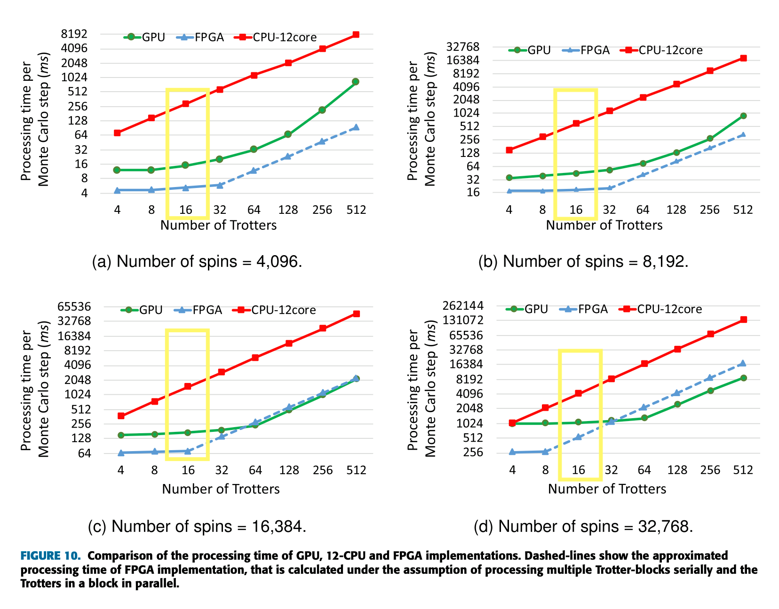

Compared with Tohoku
#spin | 4096 | 8192 | 16384 | 32768
FPGA (ms/STEP) | 5 | 16 | 65 | 512 (predict)
Tohoku GPU (ms/STEP) | 8 | 48 | 170 | 1024
Combined judge (ms/STEP) | 0.2593 | 0.53036 | 1.04262 | 11.23064
More Paralleled (ms/STEP) | 0.09747 | 0.19393 | 0.60001 | 1.15684

Slide 6
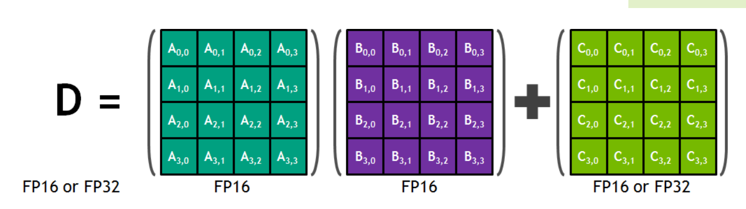
Tensor core constraints
Google designed TPU (Tensor Processing Unit) for tensor calculation
NVIDIA released Volta microarchitecture featuring specialized computing units called “Tensor Cores”
TC on
DNN
Matrix multiplication
Constraint:
M, N, K: multiple of 16
FP32
FP32
Notes:
Tensor Processing Unit: 專門處理張量積的東西 （張量處理器）

Slide 7
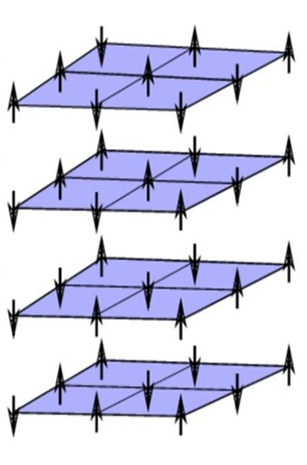
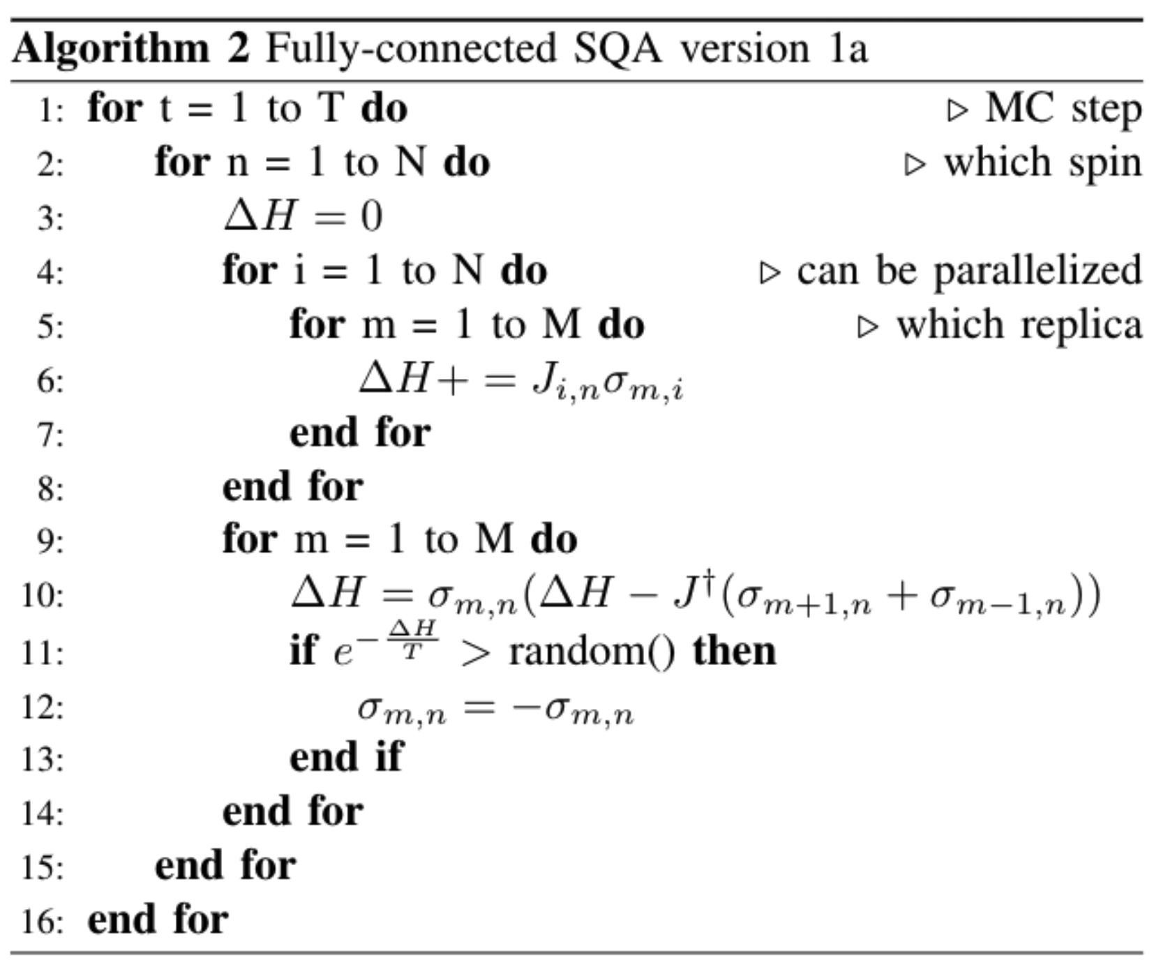
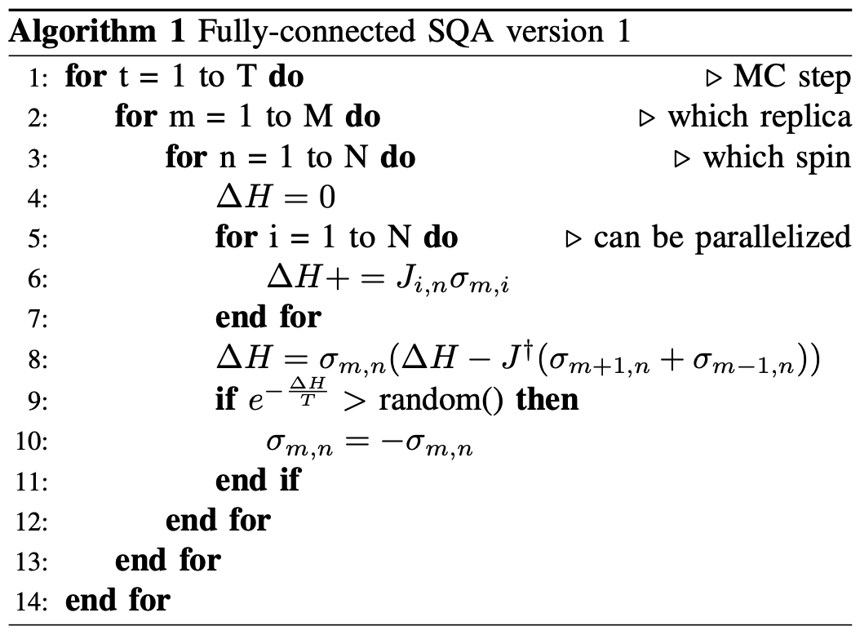
SQA

Slide 8
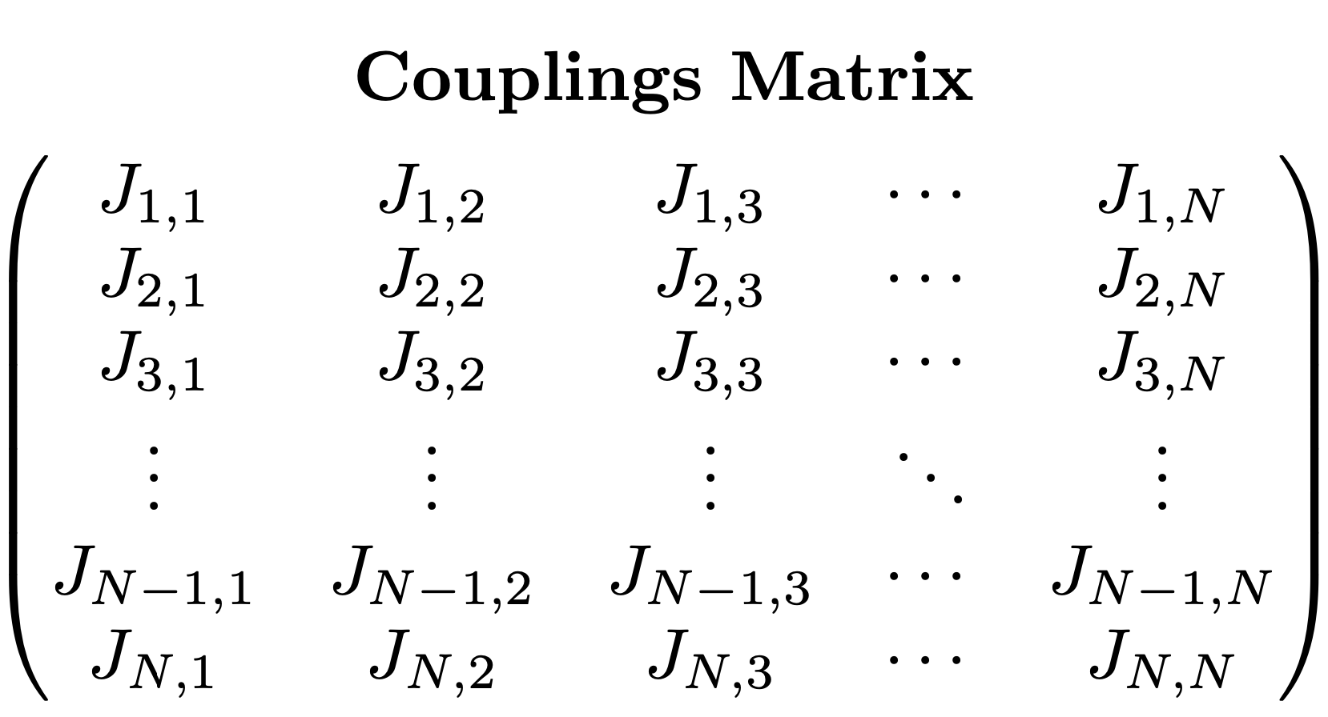
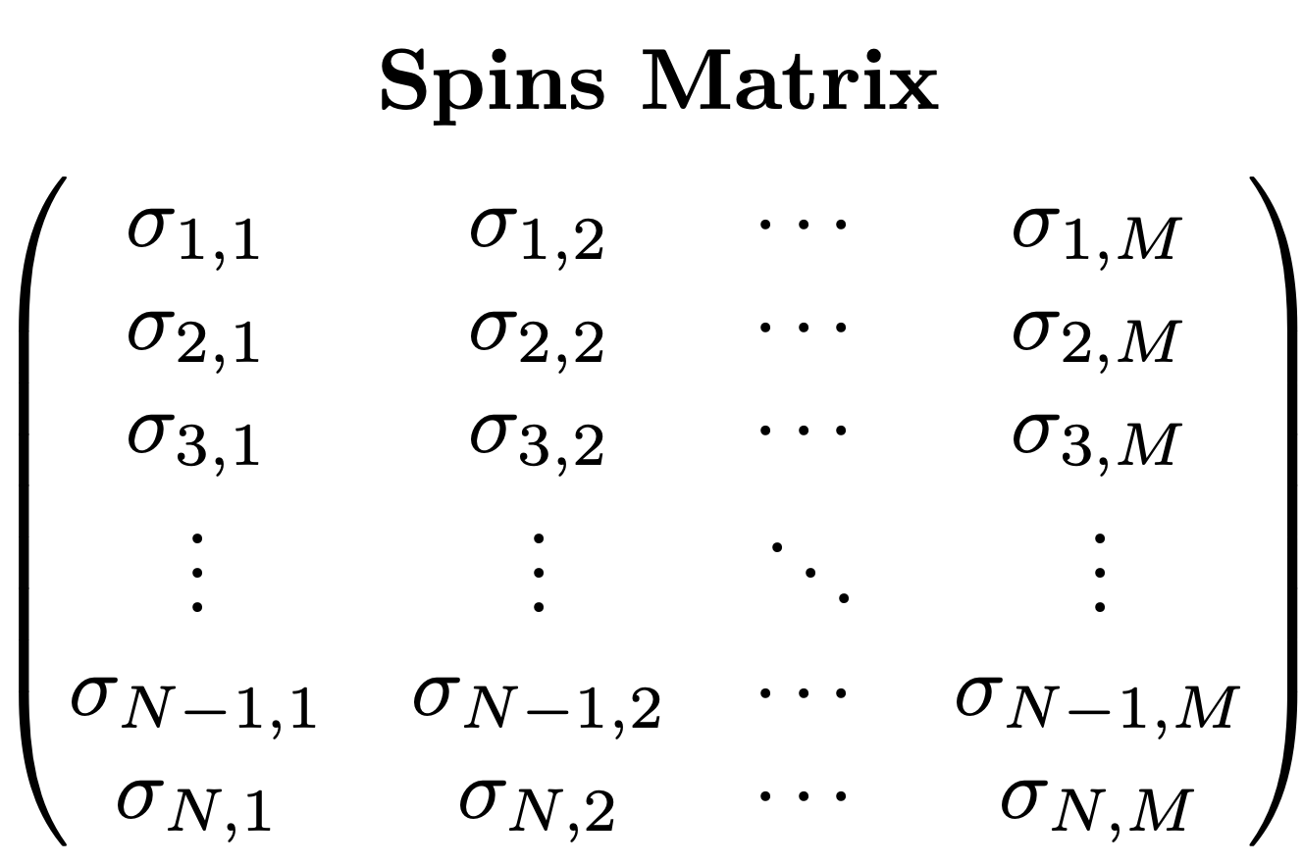
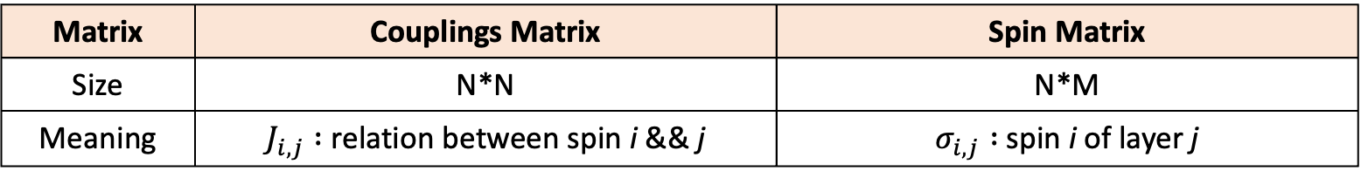
Mapped to Matrix
Matrix | Couplings Matrix | Spin Matrix
Size | N*N | N*M
Meaning | $J_{i,j} :$ relation between spin i && j | $σ_{i,j} :$spin i of layer j

Slide 9
Implementation

Slide 10
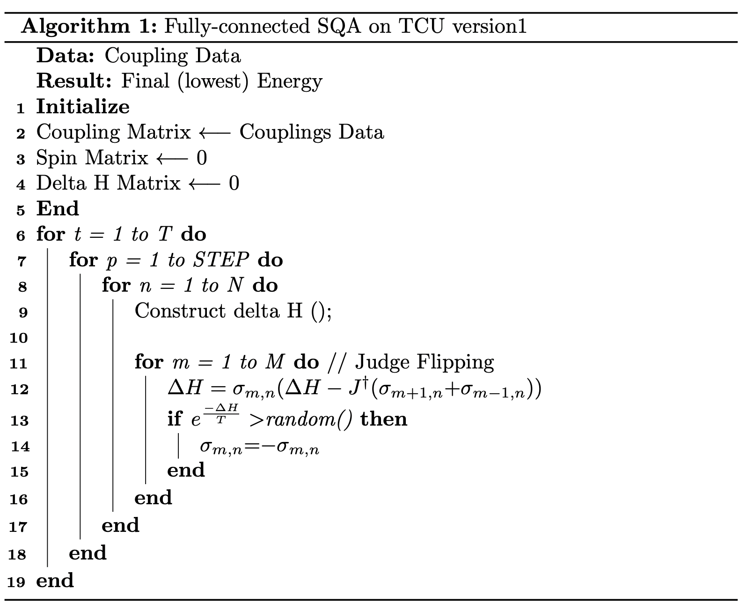




Algorithm -1
Step1
Step2

Slide 11

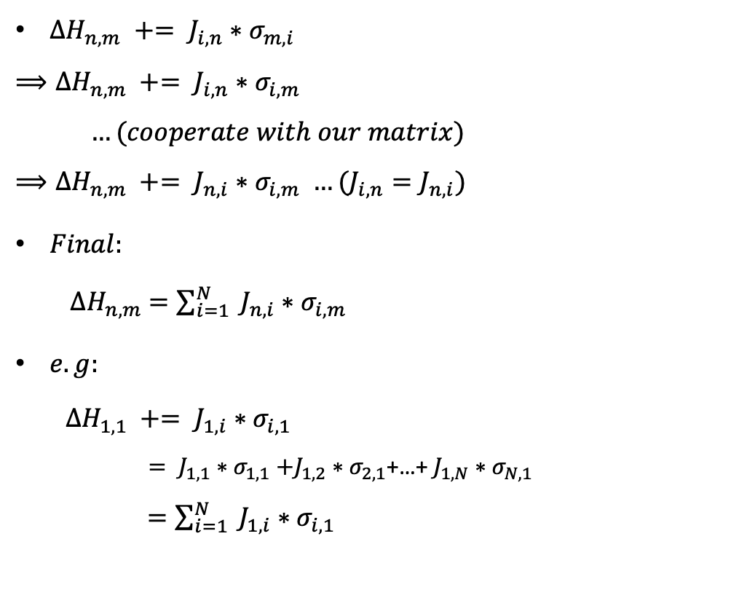
Construct $∆H$
${∆H}_{n,m} += J_{i,n}{∗σ}_{m,i}$
$$⟹{∆H}_{n,m} += J_{i,n}{∗σ}_{i,m}$$
$…(cooperate with our matrix)$
$$⟹{∆H}_{n,m} += J_{n,i}{∗σ}_{i,m} …(J_{i,n}=J_{n,i})$$
$Final:$
${∆H}_{n,m}$ $=\sum_{i=1}^{N}{ J_{n,i}{∗σ}_{i,m}}$
$e.g:$
${∆H}_{1,1} += J_{1,i}{∗σ}_{i,1}$
$= J_{1,1}{∗σ}_{1,1}+J_{1,2}{∗σ}_{2,1}$+…+ $J_{1,N}{∗σ}_{N,1}$
$=\sum_{i=1}^{N}{ J_{1,i}{∗σ}_{i,1}}$
Goal:

Slide 12
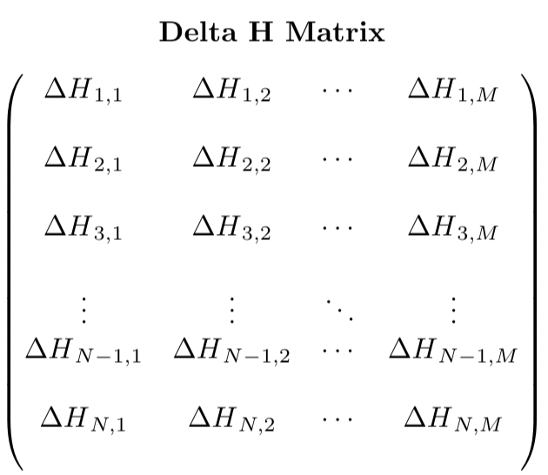
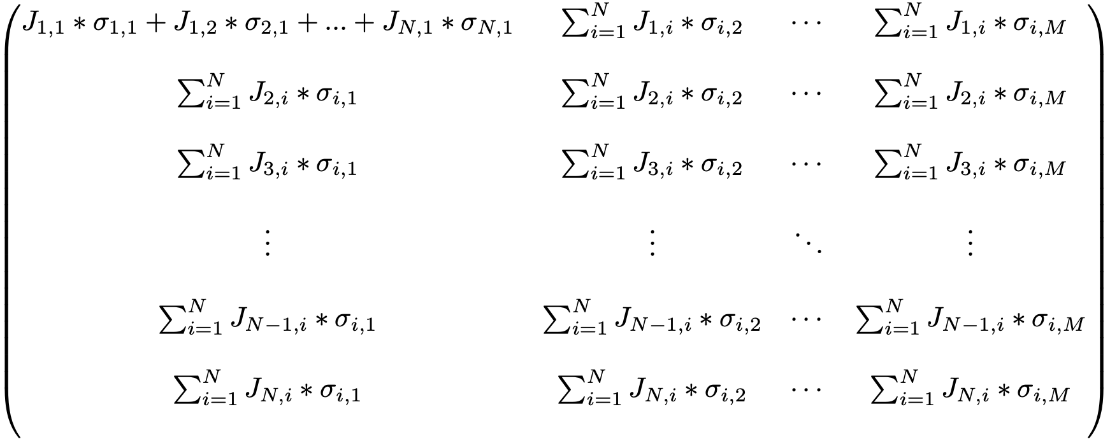
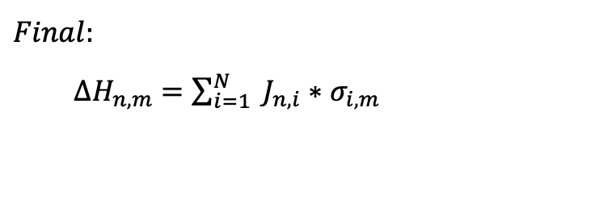
Cont’d
Goal:
$$Final:$$
${∆H}_{n,m}$ $=\sum_{i=1}^{N}{ J_{n,i}{∗σ}_{i,m}}$
*
=
=

Slide 13
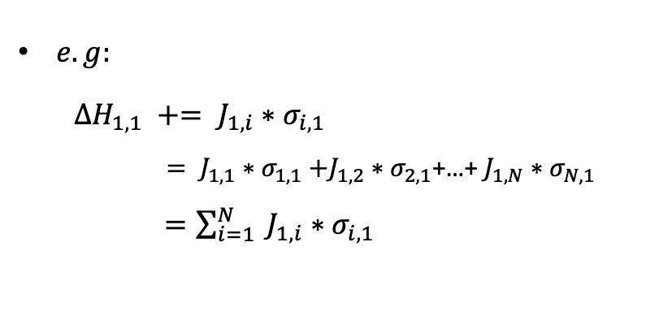
Small conclusion
$e.g:$
${∆H}_{1,1} += J_{1,i}{∗σ}_{i,1}$
$= J_{1,1}{∗σ}_{1,1}+J_{1,2}{∗σ}_{2,1}$+…+ $J_{1,N}{∗σ}_{N,1}$
$=\sum_{i=1}^{N}{ J_{1,i}{∗σ}_{i,1}}$
Conclude:
One matrix multiplication
Get N*M (all) spins’ energy
A spin energy is related to the spins located at the same layer
Notes:
實際乘一次
然後這裡要提到，這時候我們可以發現，一個spin的能量實際上只會合同一層的spin有關

Slide 14



A spin energy is related to
For one construction:
related with:
spins on the same layers
For spin flipping:
spin on the upper layer and lower later
on the same location

Slide 15
Flipping spins
＠ Temp = t
layer 1
layer 2
…
layer (n-1)
layer n
For one spin, the spin energy will only impact by the spins on the same layer.
That is, we can only flip one spin on one layer before updating all the N spins’ energies on the same layer.
So, we flipped the same i-th spin for all M layers.
All N*M spins’ energies need to be updated.
…
Notes:
在知道怎麼construct delta H for all the N*M spins後，我們開始看怎麼做fliiping

Slide 16
Results
Testcase | G1 | G22 | G48 | G65 | G77 | G81
#spin | 1024 | 2048 | 4096 | 8192 | 16384 | 32768
Actual #spin | 800 | 2000 | 3000 | 8000 | 14000 | 20000
Correlation | 19176 | 19990 | 6000 | 16000 | 28000 | 40000
#layers, M = 16
cudac++
GPU: RTX 3080
Database: Gset
#spin | 1024 | 2048 | 4096 | 8192 | 16384 | 32768
Shih fastest
GPU | 0.4641827 | 3.3816429 | 7.0664575 | 8.70533 | 107.3607445 | X
Tensor Core Unit (TC, TCU)
Old method / CPU (Last time) | 9.51994 | 23.42601 | 93.009529 | 544.421387 | 3947.98145 | 30947.7402

Slide 17
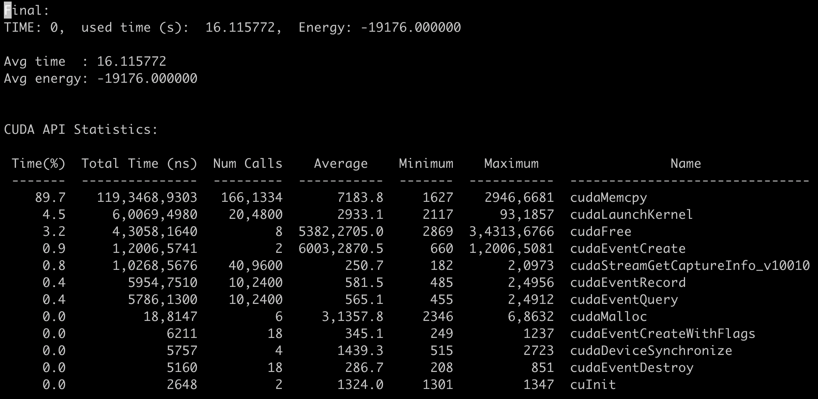
Nsight – NVIDIA profiler
For cuda toolkit 10.0 (or upper) Nsight
Nsystem, nvprof
Eg: version4.3
#spins: 1024
#layer: 16

Slide 18
Results
Testcase | G1 | G22 | G48 | G65 | G77 | G81
#spin | 1024 | 2048 | 4096 | 8192 | 16384 | 32768
Actual #spin | 800 | 2000 | 3000 | 8000 | 14000 | 20000
Correlation | 19176 | 19990 | 6000 | 16000 | 28000 | 40000
#layers, M = 16
cudac++
GPU: RTX 3080
Database: Gset
#spin | 1024 | 2048 | 4096 | 8192 | 16384 | 32768
Shih fastest
GPU | 0.4641827 | 3.3816429 | 7.0664575 | 8.70533 | 107.3607445 | X
Tensor Core Unit (TC, TCU)
Old method / CPU (Last time) | 9.51994 | 23.42601 | 93.009529 | 544.421387 | 3947.98145 | 30947.7402
Old method / GPU | 1.200057 | 7.618928 | 76.051292 | 402.099854 | 2541.241699 | (Running)
New method / CPU | 9.270058 | 18.520014 | 37.323368 | 75.925293 | 156.287231 | 323.419464
New method / GPU | 0.683909 | 1.813468 | 4.254304 | 9.384867 | 22.271311 | 50.692780

Slide 19
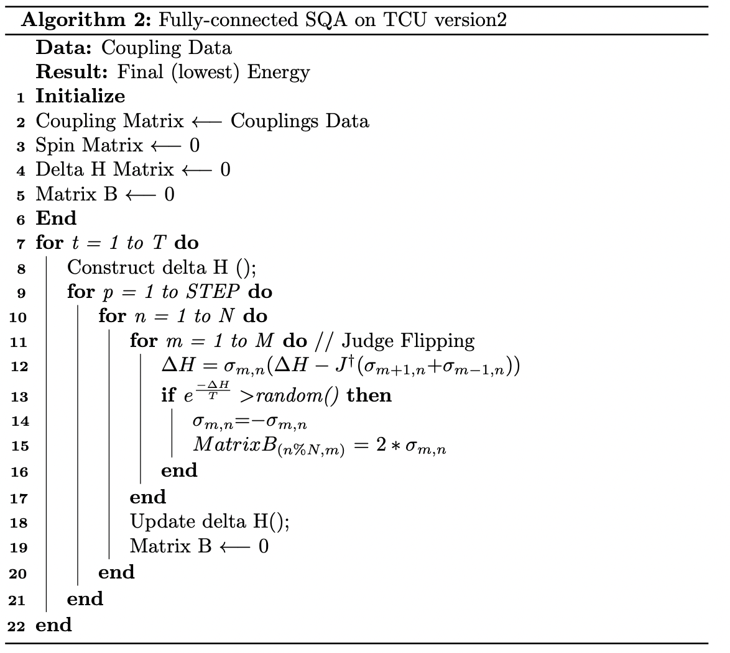
Algorithm -2
1- times
(N*STEPS) - times
(N*STEPS-1) - times

Slide 20
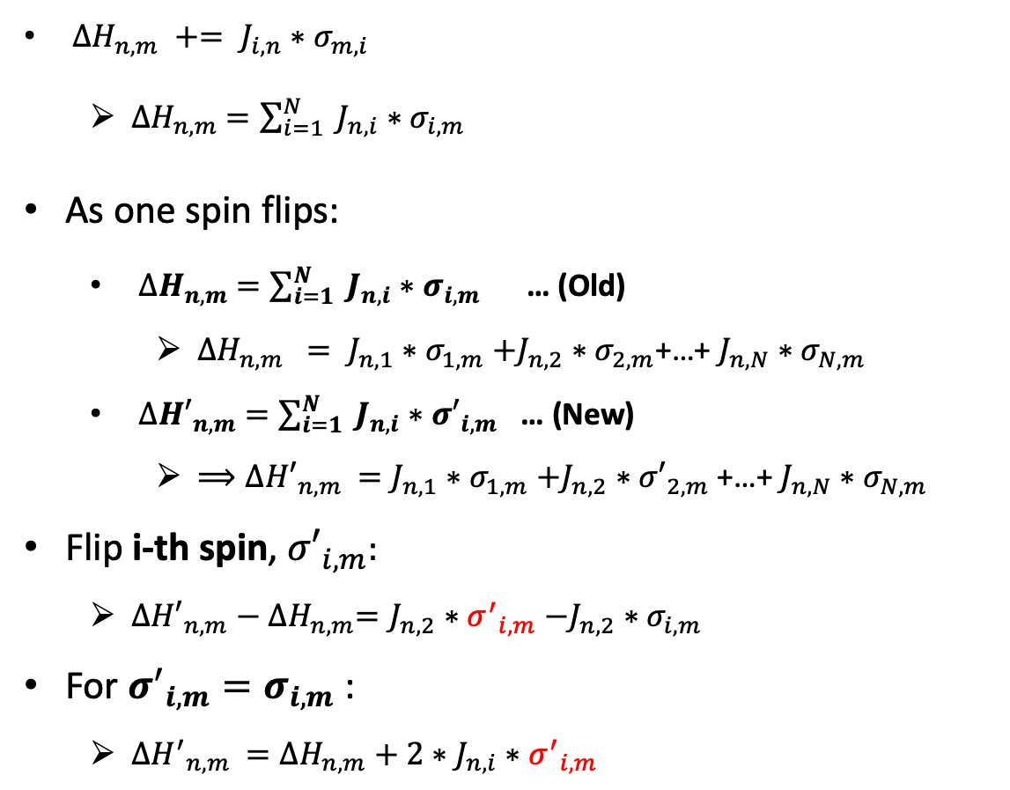
Update spins
Construct delta H
${∆H}_{n,m} += J_{i,n}{∗σ}_{m,i}$
${∆H}_{n,m}$ $=\sum_{i=1}^{N}{ J_{n,i}{∗σ}_{i,m}}$
As one spin flips:
${∆H}_{n,m}$ $=\sum_{i=1}^{N}{ J_{n,i}{∗σ}_{i,m}}$ … (Old)
${∆H}_{n,m} = J_{n,1}{∗σ}_{1,m}+J_{n,2}{∗σ}_{2,m}$+…+ $J_{n,N}{∗σ}_{N,m}$
${∆H′}_{n,m}$ $=\sum_{i=1}^{N}{ J_{n,i}{∗σ′}_{i,m}}$ … (New)
${⟹∆H′}_{n,m} =J_{n,1}{∗σ}_{1,m}+J_{n,2}{∗σ′}_{2,m}\text{+…+ }J_{n,N}{∗σ}_{N,m}$
Flip i-th spin, ${σ′}_{i,m}$:
${∆H′}_{n,m}−{∆H}_{n,m}=J_{n,2}{∗σ^{′}}_{i,m}−J_{n,2}{∗σ}_{i,m}$
For ${σ^{′}}_{i,m}=σ_{i,m}$ :
${∆H^{′}}_{n,m} ={∆H}_{n,m}+2∗J_{n,i}{∗σ^{′}}_{i,m}$
Caused effect:
Update N*M spins’ energy:
O(N*N*M) -> O(2*N*M)
Notes:
在知道怎麼construct delta H for all the N*M spins後，我們開始看怎麼做fliiping

Slide 21
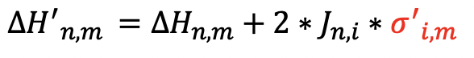
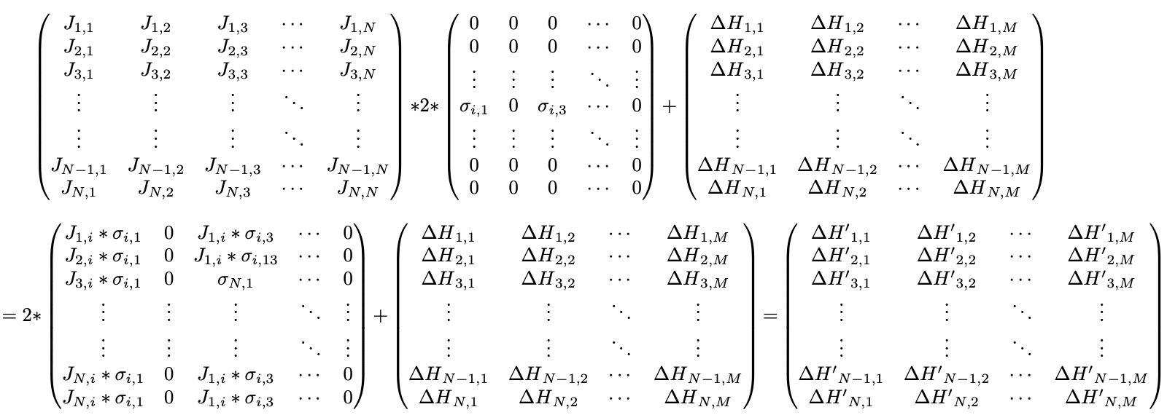
Goal:
What we have, RTX 3080 pros:
RTX 3080 will Condensed zero matrix automatically!
What we need to do:
a. Mapped our goal to the matrix
b. Matrix must content with ‘0’!
Example: assume odd spins flipped, even spins didn’t.

Slide 22
Problems
(N*M-N) redundant multiplication.
Although RTX 3080 condensed the zero matrix, but we could modify this problem with a small trick to get an acceleration.

Slide 23
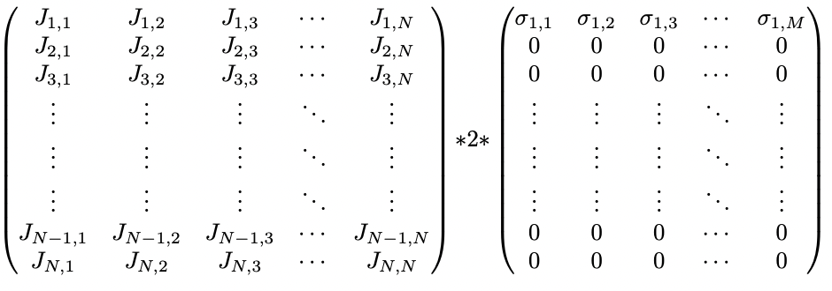
Small trick
Size: 16 (M)
Size: 16 (M)
Size: 16 (M)
Size: N

Slide 24
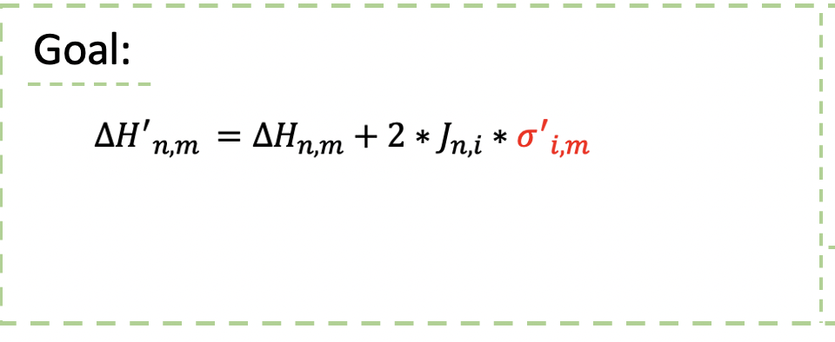

Improved
Version 1
After flipping M spins
Update delta H:
Cost O(N*N*M) multiplication
Version 2
After flipping M spins
Update delta H:
Cost O(N*M*M) multiplication
As N very large
M seems like a const!

Slide 25
Results
Testcase | G1 | G22 | G48 | G65 | G77 | G81
#spin | 1024 | 2048 | 4096 | 8192 | 16384 | 32768
Actual #spin | 800 | 2000 | 3000 | 8000 | 14000 | 20000
Correlation | 19176 | 19990 | 6000 | 16000 | 28000 | 40000
M = 16, STEP=100
cudac++
GPU: RTX 3080
Database: Gset
Unit: (ms/MC STEP)
#spin | 1024 | 2048 | 4096 | 8192 | 16384 | 32768
Shih fastest GPU | 1.0775 | 8.87061 | 30.65105 | 87.0533 | 290.12831 | 1119.69917
Tensor Core Unit (TC, TCU)
Old method / CPU (Last time) | 95.1994 | 234.2601 | 930.09529 | 5444.21387 | 39479.8145 | 309477.402
Old method / GPU | 12.00057 | 76.18928 | 760.51292 | 4020.99854 | 25412.41699
New method / CPU | 92.70058 | 185.20014 | 373.23368 | 759.25293 | 1562.87231 | 3234.19464
New method / GPU | 6.83909 | 18.13468 | 42.54304 | 93.84867 | 222.71311 | 506.9278

Slide 26
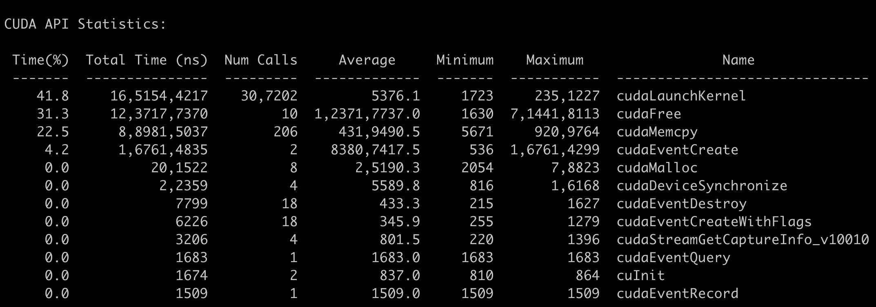
Nsight – NVIDIA profiler
After M flipping:
Update() -> call kernel
Judge flipping () -> call kernel
Totally: call (STEP*N) times kernels -> Too many!

Slide 27
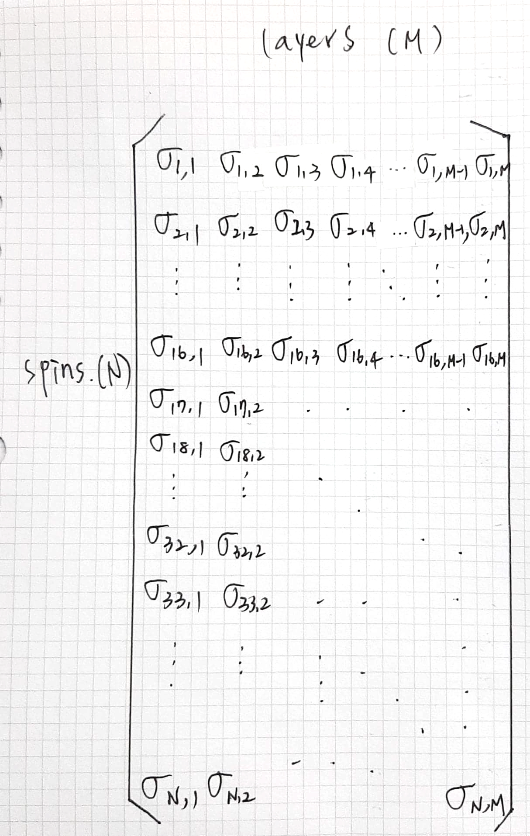
Acceleration
Pre-calculate
Update 16 spins becomes 16*16 spins at once
Cost: GPU pre calculate 15*16 spins new energies
Combined judge
More Paralleled

Slide 28
Acceleration
Pre-calculate. 513
Update 16 spins becomes 16*16 spins at once
Cost: GPU pre calculate 15*16 spins new energies
Combined judge . 514
Parallel flipping the even layers
Count the blue blocks at the same time
Parallel flipping the odd layers
Count the non-color blocks at the same time
Pros: 8 threads parallel
More Paralleled. 515, 516(random在裡面)

Slide 29
Acceleration
Pre-calculate
Update 16 spins becomes 16*16 spins at once
Cost: GPU pre calculate 15*16 spins new energies
Cost: GPU pre calculate 15*16 spins new energies
Combined judge
Parallel flipping the even layers
Count the blue blocks at the same time
Parallel flipping the odd layers
Count the non-color blocks at the same time
Pros: 8 threads parallel
More Paralleled
Count the blue blocks at the same time
Count the non-color blocks at the same time
Pros: 16 threads parallel,
Update #spins: 16*16- > 32*16

Slide 30
Results
M = 16, STEP=100
cudac++
GPU: RTX 3080
Database: Gset
Unit: (ms/MC STEP)
Testcase | G1 | G22 | G48 | G65 | G77 | G81
#spin | 1024 | 2048 | 4096 | 8192 | 16384 | 32768
Actual #spin | 800 | 2000 | 3000 | 8000 | 14000 | 20000
Correlation | 19176 | 19990 | 6000 | 16000 | 28000 | 40000
#spin | 1024 | 2048 | 4096 | 8192 | 16384 | 32768
Tensor Core Unit (TC, TCU)
Old method / CPU (Last time) | 95.1994 | 234.2601 | 930.09529 | 5444.21387 | 39479.8145 | 309477.402
Old method / GPU | 12.00057 | 76.18928 | 760.51292 | 4020.99854 | 25412.41699
Tensor Core Unit (TC, TCU) - New Method
New method v1 (previous table fastest) | 6.83909 | 18.13468 | 42.54304 | 93.84867 | 222.71311 | 506.9278
Pre-calculate | 0.32338 | 0.63744 | 1.32383 | 12.81606 | 38.97931 | 90.83975
Combined judge | 0.2593 | 0.53036 | 1.04262 | 11.23064 | 45.71822 | 106.25631
More Paralleled | 0.09747 | 0.19393 | 0.60001 | 1.15684 | 2.42656 | 25.0656

Slide 31
Compared with Tohoku
#spin | 4096 | 8192 | 16384 | 32768
FPGA (ms/STEP) | 5 | 16 | 65 | 512 (predict)
Tohoku GPU (ms/STEP) | 8 | 48 | 170 | 1024
Combined judge (ms/STEP) | 0.2593 | 0.53036 | 1.04262 | 11.23064
More Paralleled (ms/STEP) | 0.09747 | 0.19393 | 0.60001 | 1.15684

Slide 32

Future work
Optimization code
Acceleration
Comparison
Different layers

Slide 33
暫存 temp temp 啦啦啦lala guagua

Slide 34
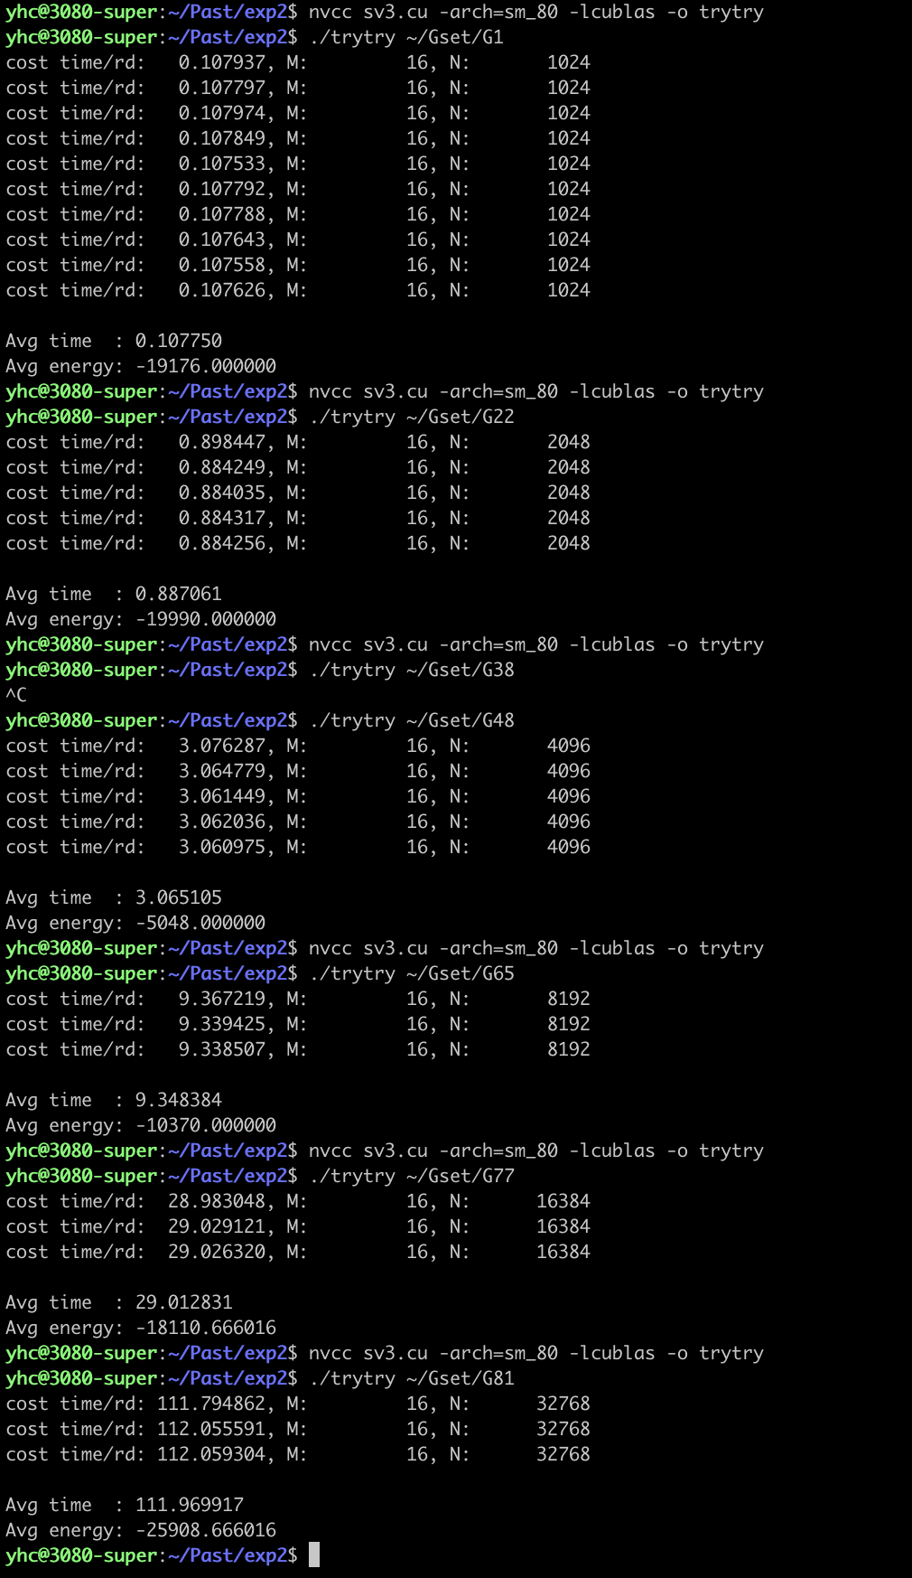
承志的跑跑過程 sv3

Slide 35
Loop interchange

Slide 36
Update order
＠ Temp = t
layer 1
layer 2
…
layer (n-1)
layer n
…

Slide 37
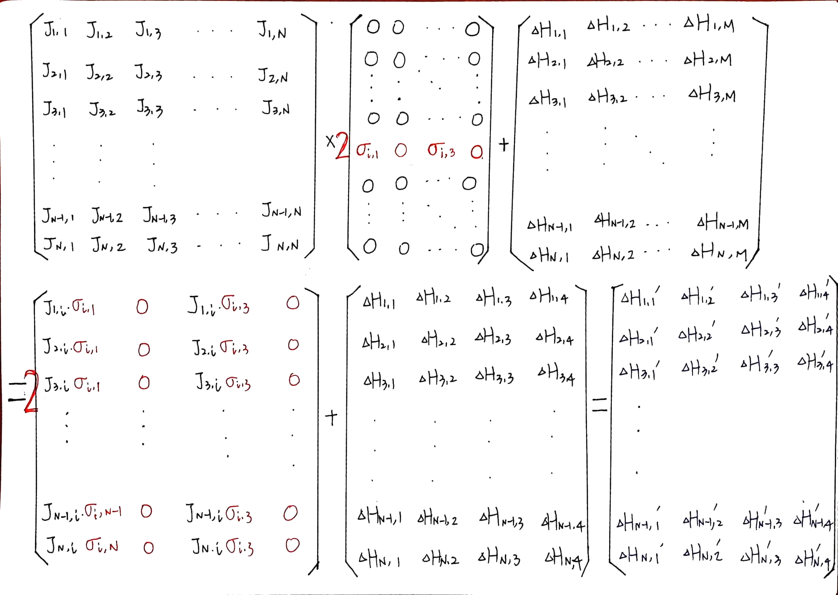
Goal:
What we have, RTX 3080 pros:
RTX 3080 will Condensed zero matrix automatically!
What we need to do:
a. Mapped our goal to the matrix
b. Matrix must content with ‘0’!

Slide 38
Problems
(N*M-N) redundant multiplication.
Although RTX 3080 condensed the zero matrix, but we could modify this problem with a small trick to get an acceleration.

Slide 39
Results
Testcase | G1 | G22 | G48 | G65 | G77 | G81
#spin | 1024 | 2048 | 4096 | 8192 | 16384 | 32768
Actual #spin | 800 | 2000 | 3000 | 8000 | 14000 | 20000
Correlation | 19176 | 19990 | 6000 | 16000 | 28000 | 40000
#layers, M = 16
cudac++
GPU: RTX 3080
Database: Gset
#spin | 1024 | 2048 | 4096 | 8192 | 16384 | 32768
Shih GPU | 0.107750 | 0.887061 | 3.065105 | 8.70533 | 29.012831 | 111.969917
Energy | -19176.000000 | -19990.000000 | -5048.000000 | -10370.000000 | -18110.666016 | -25908.666016
Tensor Core Unit (TC, TCU)
Combine judge | 0.032338 | 0.063744 | 0.132383 | 1.281606 | 3.897931 | 9.083975
Energy | -19176.000000 | -19990.000000 | -5918.000000 | -10870.000000 | -19088.800781 | -27281.199219
More Parallel | 0.013120 | 0.026294 | 0.071297 | 0.136855 | 2.541875 | 9.829713
Energy | -19176.000000 | -19990.000000 | -3400.000000 | -6082.000000 | -9704.000000 | -13446.000000

Slide 40
Tohoku 比較

